Slide 1
15.763 Administrative Issues
(optional) recitation is most Fridays 11:30-12:30 via zoom
Students taking the course for credit will need to join a group and work with that group throughout the course
Listeners can work with a group but individual assignments will not be graded
Group formation
  Please form your group by 12:30 p.m. on Friday
  I will create groups Friday afternoon

Slide 2


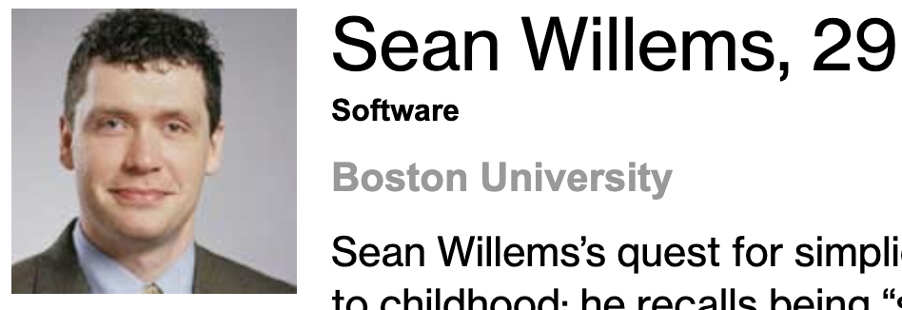
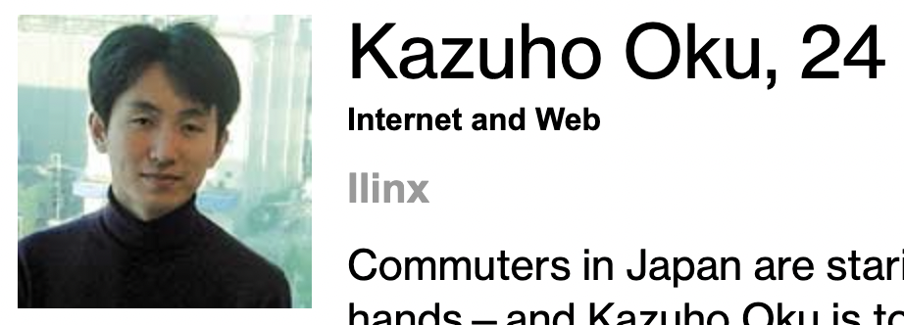

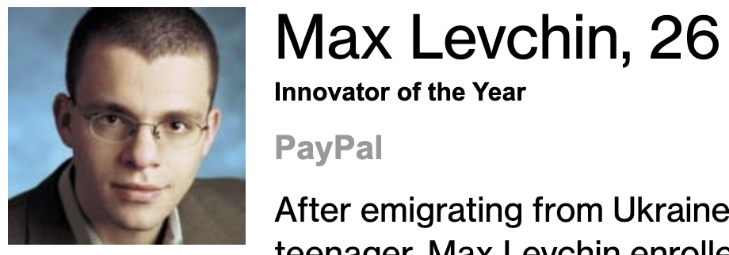
2002 Technology Review

Slide 4
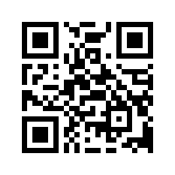
Please complete the end-of-class two-question survey
What is your main learning?
What is your unanswered question?
https://bit.ly/15763end

